Slide 1
Taipei House Rental 2018
106753038 張筆翔
107753042 朱奕寧

Slide 2
Taipei House Rental 2018
Data
Goal
Modeling
Demo

Slide 3
1
Data

Slide 4

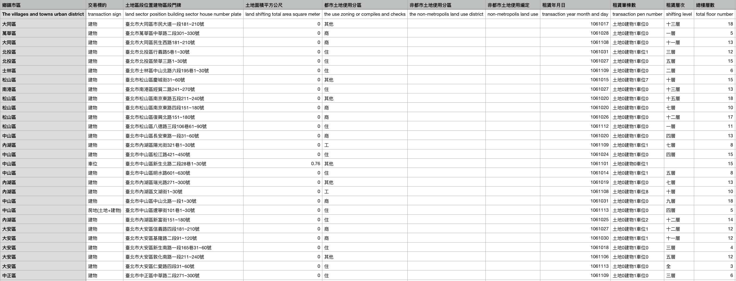
Data Source
Dept of Land Administration M. O. I.
( https://lvr.land.moi.gov.tw/homePage.action )
Data Content
Region, Address, Size, Date …

Slide 5
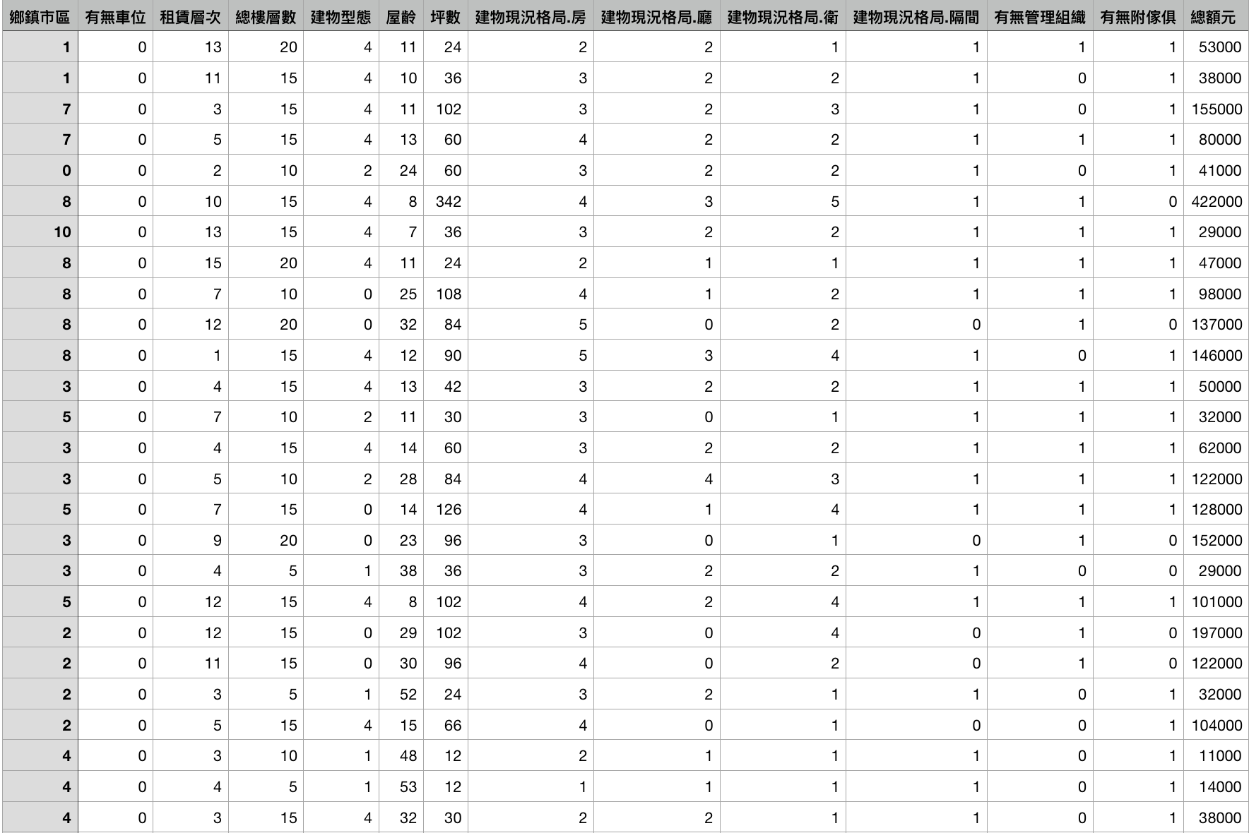
Modifying value
Region: change Chinese region name into integer index
Parking lot: 0 -> No, 1 -> Yes
Rental Floor: Change Chinese name into integer
Total Floor: Change Chinese name into integer
Years: Fill the null value by average
Administrator: 0 -> No, 1 -> Yes
Furniture: 0 -> No, 1 -> Yes
Remove the data we will not use.

Slide 6
2
Modeling

Slide 7

RandomForest
Perform 5-fold cross-validation
Testing Accuracy: 0.1584543
Training Accuracy: 0.9816459
Validation Accuracy: 0.81573

Slide 8
3
Goal

Slide 9
Data training
Searching for prediction data
Data processing

Slide 10
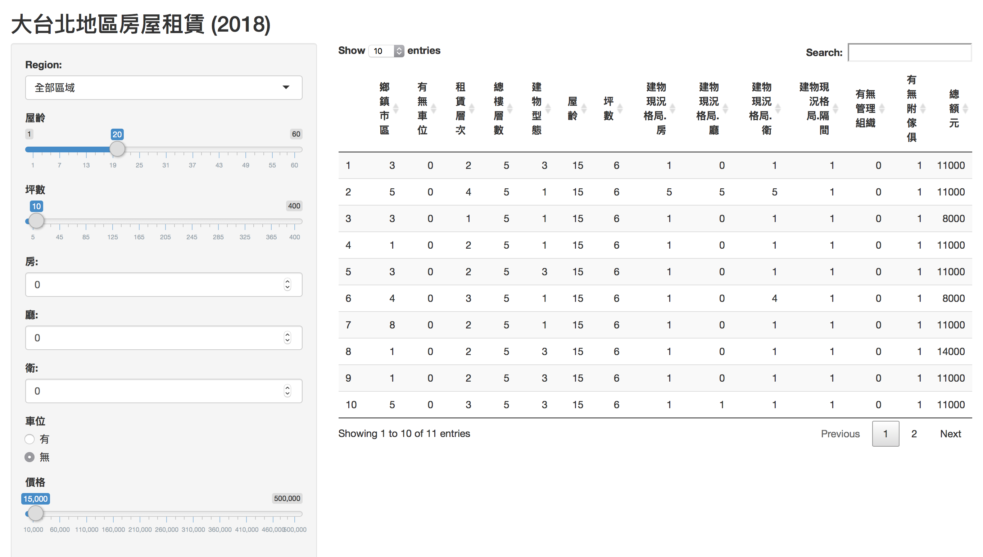
User Interface

Slide 11
4
Website

Slide 12
Website
https://ryuuuuuu.shinyapps.io/Taipei_House_Rental_2018/

Slide 13
Challenge
https://ryuuuuuu.shinyapps.io/Taipei_House_Rental_2018/
Number of data is small
Values in the specific column are disparity

Slide 14
END

